Slide 1

British Airways
FOR PURPOSES OF FORAGE VIRTUAL WORK EXPERIENCE PROGRAM
Customer ratings analysis and insights
2023-01-06

Slide 2
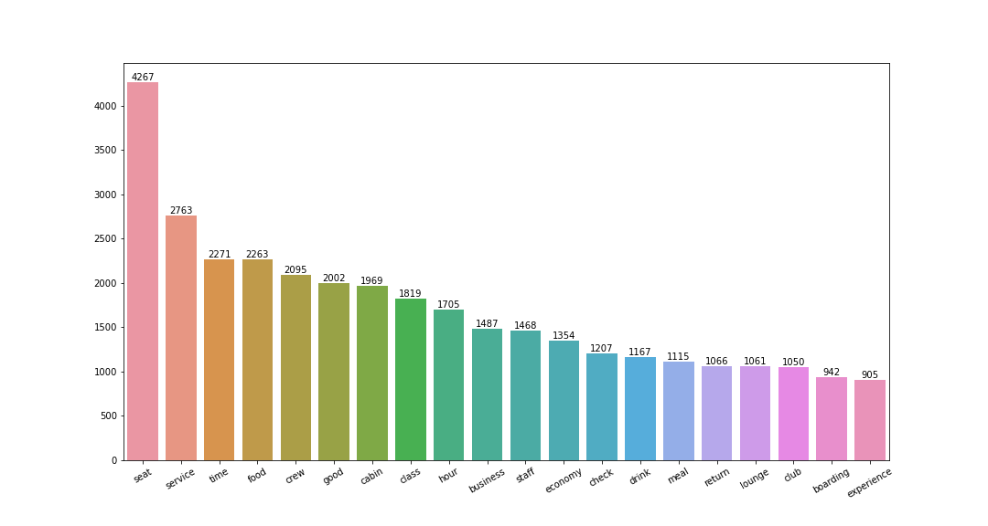
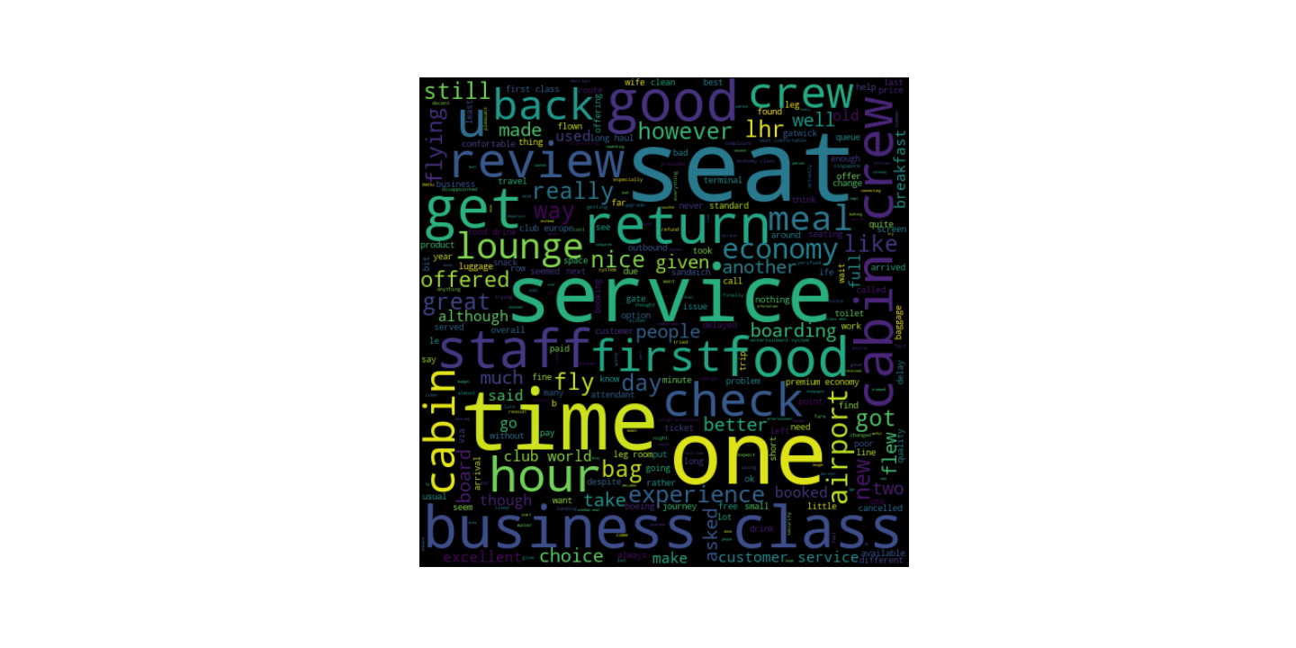
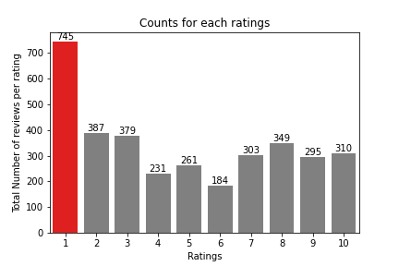
FOR PURPOSES OF FORAGE VIRTUAL WORK EXPERIENCE PROGRAM
Customer Ratings Insights and Analysis
Keywords frequently spoken about by reviewers
3444 Total Reviews Analyzed
On further analysis into the words, we noticed;
‘All customers liked the cabin crew staffs and services, a lot of people travelled via business class, but had distaste for waiting time…
Focus should be on Economy class service, seats, enhanced inflight entertainment experience and importantly delays. Enhance the experience of business class, it seems customers want value for money. Improve customer service on refund requests and process.
Average Overall Rating
4.84/10
What customers are happy and unsatisfied about for different ratings class:
7-10 ratings wrote about comfortable seats, good inflight entertainment, descent food quality.
4-6 ratings faced problem with small entertainment screen, long passport check queue, bad business class experience.
1-3 ratings wrote dissatisfaction on congested middle seat and small screen while they liked the seats and the food.
Reviews from
69 Countries
A rating of 1 doubling any other rating shows the need to urgently improve on customer experience as this might have been lost on the average rating

